Slide 1


BASIC PRINCIPLES OF PROJECT MANAGEMENT
Lecturers : Prof . Nguyễn Văn Hùng
Assoc. Prof. Nguyễn Hải Đăng
Dr. Nguyễn Tường Lan
MSc . Nguyễn Lâm Cường
Assistant Lecturer :
Ms : Đỗ Hoàng Yến
Academic Year : 2025-2026

Slide 2
PART I : PROJECT
Chapter 1- Introduction into the course : Basic Principles of Project Management
Chapter 2 - General Project . Knowledge
Chapter 3 - Types of Projects :
- Classification of Projects
- Overview of some representative examples of Projects

Slide 3
PART II - PROJECT MANAGEMENT BASICS
Lecture 4 –Chapter 1 : Values ; Needs of Project management
  Lecture 5 – Chapter 2 :The Basic Phases and steps of the Project Management ; Project management body of Knowledge and Knowledge areas of Project management .
  Lecture 6 : Chapter 3 :Project Manager , Project Organization and Team in Project Management .
  Lecture 7 - Chapter 4 : Project Planning ; Project Management Planning
  Lecture 8 - Chapter 4 Project Scheduling ; P. Monitoring and Controlling ; P. Evaluation and Termination .

Slide 4
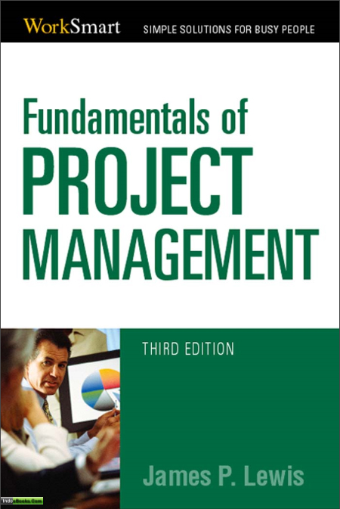

Slide 5
PART II
PROJECT MANAGEMENT BASICS
Lecture 4 – Chapter 1
Values, Needs of Project Management

Slide 6
From these definitions, the following definition is more appropriate for us:
“A project is a temporary endeavour undertaken to create a unique product, service or result in order to achieve an outcome.”
Australian Institute of Project Management (AIPM): AIPM Professional Competency Standards for Project Management 2008 Edition 10.
Endeavour /ɪnˈdevə(r)/an attempt to do something, especially something new or difficult

Slide 7
5. Characteristics of Projects
Specific deliverable/dɪˈlɪvərəbl/ ( project product )
A specific time frame /freɪm/the length of time that is used or available for something
A budget
Working across organizational boundaries
Unique /juˈniːk/ specifications
( being the only one of its kind )-duy nhất , độc nhất
Characteristics /ˌkærəktəˈrɪstɪks /

Slide 8
6. Other Common Characteristics of Projects
Multidisciplinary ( involving different subjects of study in one activity or involving people from different types of work or who have different types of knowledge ; liên ngành )
Complex (involving a lot of different but related parts ; daughter projects )
Conflict
Part of Programs

Slide 9
Overlook of some very important Implemented Projects in Vietnam
We are going to make an analysis of some implemented projects . analysis/əˈnæləsɪs/ the detailed study or examination of something in order to understand more about it; the result of the study ; phân tích interpretation/ɪnˌtɜːprəˈteɪʃn/
​ the particular way in which something is understood or explained ; diễn giải
“Phân tích” có nghĩa là 'kiểm tra' nội dung , trong khi
'diễn giải' có nghĩa là 'giải thích' về nội dung. · phân tích, mổ xẻ, phân tích phân đoạn.

Slide 10
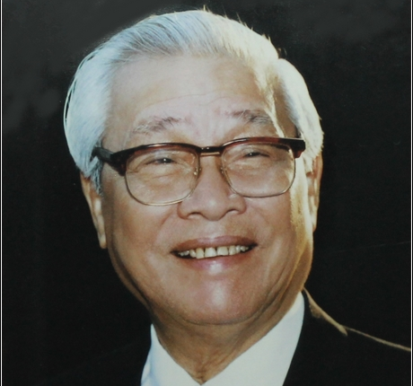
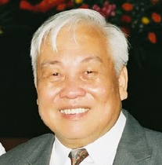
TRƯỜNG ĐẠI HỌC KHOA HỌC VÀ CÔNG NGHỆ HÀ NỘI
HOÀN CẢNH LỊCH SỬ VÀ Ý TƯỞNG THÀNH LẬP TRƯỜNG ĐẠI HỌC KHOA HỌC VÀ CÔNG NGHỆ HÀ NỘI
Prime Minister Võ Văn Kiệt
(23/11/1922- 2008 )
Duration Term : 1991 – 1997
Academician Nguyễn văn Hiệu
(1938-2021 )
VAST President : 1983-1994
Initiator of USTH Project

Slide 11
4 Key Scientific and Technological
Fields of the Country
1992-1997

Slide 12


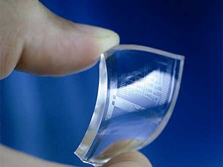
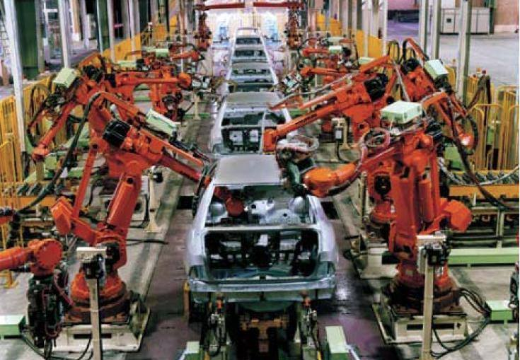
BIOTECHNOLOGY
INFORMATION TECHNOLOGY
NEW MATERIALS
AUTOMATION

Slide 13
Implemented Projects
1- Project : North-South 500 kv high- voltage transmission line, circuit /ˈsɜːkɪt/ 1
Prime Minister Võ Văn Kiệt

Slide 14
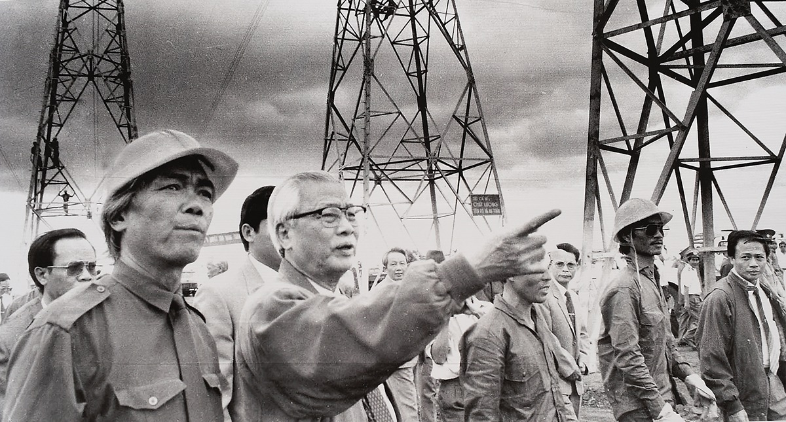
Ảnh thủ tuong

Slide 15
Electronic line System in VN
Hệ thống điện Việt Nam Gồm có các nhà máy điện, các lưới điện, các hộ tiêu thụ được liên kết với nhau thành một hệ thống để thực hiện 4 quá trình sản xuất, truyền tải, phân phối và tiêu thụ điện năng trong lãnh thổ Việt Nam. Các cấp điện áp đang vận hành trên hệ thống điện Việt Nam: 500kV, 220kV, 110kV, 35kV, 22kV, 10kV, 6 Kv; Tần số vận hành lưới điện: 50 hz. Kết cấu pha, dây: 3 pha,2 pha và 1 pha.
. Nhà máy điện: Là nơi sản xuất (chuyển đổi) ra điện năng từ các dạng năng lượng khác. Ví dụ: Nhà máy nhiệt điện: Phả Lại, Uông Bí...; Nhà máy thủy điện: Hòa Bình, Sơn La...; Nhà máy điện hạt nhân: Ninh Thuận (đang xây dựng).
. Lưới điện: Là hệ thống truyền tải và phân phối điện năng từ nơi sản xuất đến nơi tiêu thụ: + Lưới hệ thống: nối các nhà máy điện với nhau và với các nút phụ tải khu vực. Ở Việt Nam lưới hệ thống do A0 quản lý, vận hành ở mức điện áp 500 kV.

Slide 16
North-South 500 KV High voltage transmission line , circuit 1
Hòa Binh- Phú Lâm
Distance : 1500 km
Started : 5/4/1992
Completed : 27/5/1994

Slide 17
Analysis of the project
North-South 500 KV High voltage transmission line
The deficit of electricity in the South ><excess of electricity in the North (Hoa binh electronic hydropower )
excess/ɪkˈses/ɪkˈses/ more than is necessary, reasonable or acceptable
deficit/ˈdefɪsɪt/ the amount by which money spent or owed is greater than money earned in a particular period of time ; thiếu hụt
Predict /prɪˈdɪkt/​to say that something will happen in the future ; dự đoán

Slide 18
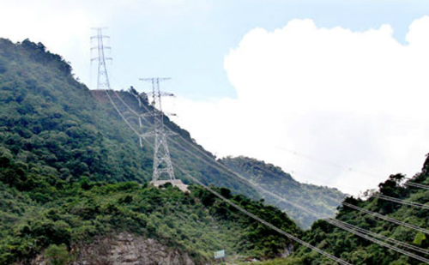

Slide 19
2. North - South500kv high voltage transmission line , circuit 2
Miracle followed by miracle
-After over 10 years of operating the North - South 500kV ultrahigh-voltage transmission line, circuit 1, on 23rd September 2005- 1st July 2008, Vietnam’s Power sector made another new miracle: Completing and putting into operation the North - South 500kV ultrahigh-voltage transmission line, circuit 2, (from 500kV Thuong Tin substation to 500kV Phu Lam substation) with a length of nearly 1,600km. Thus, the North - South 500kV power transmission system has had two parallel circuits to create a strong connection, safe and reliable operation for the national power transmission system.
-The construction of circuit 1 was participated by foreign experts from design consultancy, technical supervision, direct checking and acceptance, etc., the work of circuit 2 was entirely undertaken by Vietnamese officials and engineers, marking the outstanding growth of the staffs and employees of Vietnam’s Power Sector.
-So far, after 25 years of operation, the North - South 500kV power transmission system has made great contributions to the socio-economic development of the country, playing a crucial role in the national power transmission system

Slide 20
North-South 500 KV High voltage transmission line , circuit 2
Substation Thuong Tin- Phú Lâm
Distance : 1600 km
Construction 2005-2008
Circuit /ˈsɜːkɪt/a line, route ; mạch

Slide 21
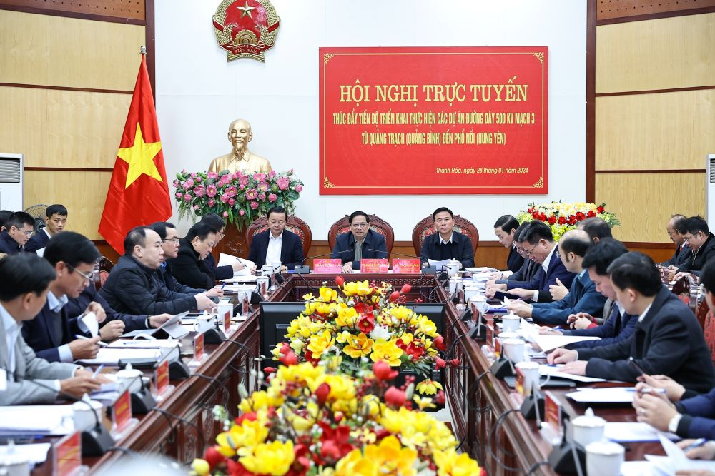
3. North - South500kv high voltage transmission line , circuit 3

Slide 22
North - South500kv high voltage transmission line , circuit 3
The construction of the 500kV circuit 3 line is essential to bolstering the North-Central 500kV transmission grid’s capacity and to ensure electricity supply for the North both now and in the future. At the same time, it enhances the transfer of power from the North Central region’s power sources to the Northern region’s load center.
Speaking at the meeting,Prime Minister Pham Minh Chinh said , the line – circuit 3 is a crucial and urgent project that will contribute significantly to national energy security, particularly in the North, as well as the national and social security.
Invested by Vietnam Electricity’s National Power Transmission Corporation (EVNNPT), the North–South 500kV ultra-high voltage power transmission line – circuit 3 stretching from Quang Binh, Ha Tinh, Nghe An, Thanh Hoa, Ninh Binh, Nam Dinh, Thai Binh, Hai Duong, and Hung Yen costs a total investment of VND22 trillion ( nghìn tỷ ) – eq. US$894 million.

Slide 23
Catlinh-Hadong Metro line 2
Part of The Improvement of The NationalTransportation system program

Slide 24
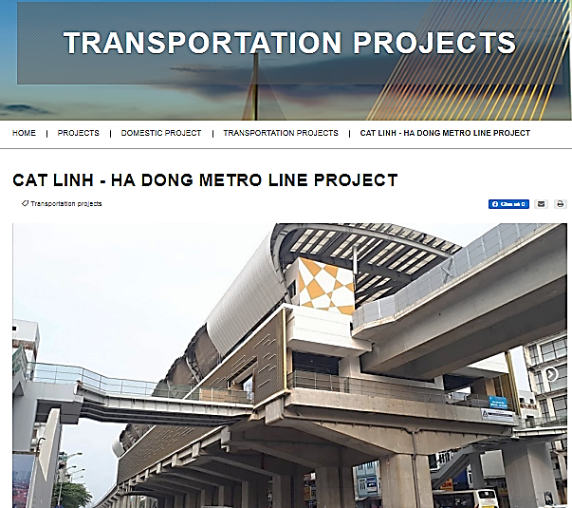
CAT LINH - HA DONG METRO LINE PROJECT

Slide 25
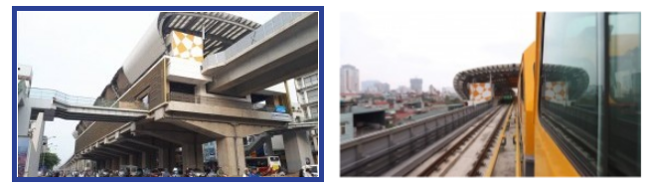

CAT LINH - HA DONG METRO LINE PROJECT

Slide 26
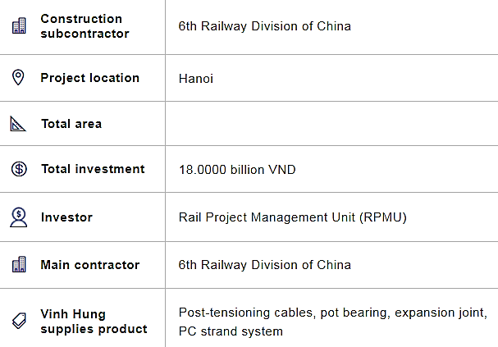
CAT LINH - HA DONG METRO LINE PROJECT

Slide 27
CAT LINH - HA DONG METRO LINE PROJECT
DESCRIPTION PROJECT
Route 2A Cat Linh - Ha Dong Metro Line is invested by the Ministry of Transport. The 13.1 km long route construction was started on October 10, 2011 and is expected to complete on 30/9/2017 .
Cat Linh - Ha Dong is the third route in the Hanoi urban railway system, and the second route of the proposed project, following the Yen Vien - Ngoc Hoi route, among eight planned lines. The project was financed by China's ODA loan, signed in 2008. The project has a total investment of USD 552.86 million in 2008, of which USD 133.86 million was from the Government of Vietnam. In addition, China's preferential loans amounted to USD 419 million. Total investment after adjustment is USD 886 million, with excess capital of USD 250 million.
2A Cat Linh - Ha Dong Metro Line had 13 trains (52 carriages) with 4 carriages/trains. The length of the train is 79 m, the height of the train from the railing to the top of the train is 3.8 m, the maximum width of the train is 2.8 m, the maximum speed is 80 km/h, the average speed of exploitation is ≥ 35 km/hour. Maximum transportation capacity is about 28,500 passengers/hour/direction. Route 2A Cat Linh - Ha Dong is equipped with 13 trains with modern technology. The train is powered by electricity with power supply system from a third rail, which is safe and stable as well as ensure the beauty of the city. The train is a two-way cab and can be reversed at both ends of the train.

Slide 28
Project : Cat linh-Hà đông Metro line 2
Type : ODA Loan from China
-Invested by Minitry of Transportation
-started :10/10/2011
Completed :10/2021 (expected 2017)
Estimated budget : 552.86 million U$
Contribution of VN : 133.86 million U$
Overspent : 250 million U$
More than 7 million passingers/year

Slide 29
Hanoi Metro line 3
Native name | Metro line 3
Status | Completed (elevated section), 43.25% under construction (underground) as of August 8th 2024
Owner | Vietnam Railways
Line number | 3
Termini | Nhon Cau Giay
Stations | Phase 1 (Nhon - Hanoi Station): 8 (current)

Slide 30
Hanoi metro line 3
The name and location of stations were finalized in the 2009 Final Feasibility Study. Based on this study, fifteen stations were reduced to 12 stations, 8 elevated and 4 underground. A twin bored tunnel concept using tunnel boring machines (TBM) was selected to tunnel 15 to 8 m underground and to utilize the centerline of existing surface roads. Two underground stations, Cát Linh and Văn Miếu, were relocated one block eastward to avoid cultural significant sites.
Budget
Beside 276 million euros from the Hanoi city's budget, the project also receives 726 million euros from the four donors - the French government (DGT), French Development Agency (AFD), Asian Development Bank (ADB), and European Investment Bank (EIB).
Construction progress
Implementation of the project is delayed by four years compared to the original schedule with completion expected in 2021. As of March 2017, the project has achieved 30% physical progress over the elapsed project life of 9 years. However, the project completion is expected to be delayed to 2027

Slide 31
The Project of Community Development :
Hunger Elimination and Poverty Reduction ( a part of the Program 135 of The Gov.)
-ODA Projects : -repaid
-non-repaid
What is the best way to eliminate the hunger ?
-The aims are : to reduce porverty In the rural , especially in the mountain areas and ensure continuos development of the Country
-Enhancing living standard
Rural /ˈrʊərəl/connected with or like the countryside ; nông thôn
areas /ˈeəriə/ lĩnh vực , vùng miền
Minority /maɪˈnɒrəti/ ?
Majority/məˈdʒɒrəti/ ?

Slide 32
REFRESHMENT

Slide 33
1- Evaluation of the implemented Projects in USA
* The status of software Projects in United States
In the book “Fundamentals of project management”, the statistics of Joseph Heagney: about of software projects of Standish Group.
17% – successfully implemented.
50% – changed the targets (overspent).
33% – canceled.
In U.S – for one year: $250 billion for software development nationwide, $80 billion – lost, 83% – trouble.

Slide 34
* The reasons why are projects failed :
Failure to align projects with organizational objectives
Poor scope
Unrealistic expectations
Lack of executive sponsorship
Lack of project management
Inability to move beyond individual and personality conflicts
Politics

Slide 35
* The reasons why projects successfully implemented :
Project sponsorship at executive level
Good project charter
Strong project management
The right mix of team players
Good decision making structure
Good communications
Team members are working toward common goals

Slide 36
What is the Project charter ?
A project charter is a formal, typically short document that describes your project in its entirety — including :
what the objectives are, how it will be carried out, and who the stakeholders are.
It is a crucial ingredient in planning the project because it is used throughout the project lifecycle.
ingredient /ɪnˈɡriːdiənt/ phần hợp thành
one of the things from which something is made

Slide 37
Project charter
The project charter typically documents:
Reasons for the project
Objectives and constraints of the project
The main stakeholders
Risks identified
Benefits of the project
General overview of the budget

Slide 38
2-Value of Project Management
* In fact : Project management is , shorthand for project, program and portfolio management. And more companies are clearly seeing the payoff from investing time, money and resources to build organizational project management expertise : lower costs, greater efficiencies, improved customer and stakeholder satisfaction, and greater competitive advantage.
An Economist Intelligence report showed that 80 percent of global executives believed having project management as a core competency helped them remain competitive during the recession.
recession : Sự suy thoái kinh tế

Slide 39
vocabulary
shorthand /ˈʃɔːthænd/ a quick way of writing using special signs or abbreviations, used especially to record what somebody is saying : bản tốc ký
Stenography / stəˈnɔgrəfi/ Tốc ký
Portfolio /pɔːtˈfəuliəu /a thin flat case used for carryindocuments,drawings : hồ sơ tóm tắt của dự án ; hồ sơ năng lực
Curriculum Vitae /kəˈrɪkjələm ˈviːtaɪ / hồ sơ ứng tuyển

Slide 40
II. The Need of Project Management
1- Definition of Project Management
⃰⃰ PROJECT MANAGEMENT is application of knowledge, skills, tools, and techniques to project activities to achieve project requirements.
⃰ PROJECT MANAGEMENT is accomplished through the application and integration of the project management processes of initiating, planning, executing, monitoring and controlling, and closing.

Slide 41
2-The need of Project management
* Leading organizations across sectors and geographic borders have been steadily embracing project management as a way to control spending and improve project results.
When the recession began, this practice became even more important. Executives discovered that adhering to project management methods and strategies reduced risks, cut costs and improved success rates—all vital to surviving the economic crisis.

Slide 42
* Good project management discipline stopped us from spending money on projects that fail,” says Ron Kasabian, general manager at global IT giant Intel, Folsom, California, USA.
In State of the PMO 2010 :
84 percent of the 291 project professionals responding said their companies have a PMO, demonstrating steady growth from 47 percent in 2000 to 77 percent in 2006 and

Slide 43
* Project Management role for the Competitive advantage
According to the Economist Intelligence Unit survey :
- 90% of global senior executives ranked project management methods as either critical or somewhat important to their ability to deliver successful projects and remain competitive .
- “A strong project management discipline brings exceptional value to the business, because when there is a demand for a product, we are the ones who deliver it,”
- “We are a key part of the business, and we adhere to the same rules, rigor and commercial goals as the rest of the organization.”

Slide 44
PROJECT MANAGEMENT IN ACTION
-The strategy and vision of the organization is linked to the execution of these projects. We need to have a strong level of project management discipline and capability to meet those expectations .
-The project management approach creates a consistent level of governance, leadership, monitoring and reporting for projects, but eliminates much of the bureaucracy and paperwork that could otherwise slow the project team.

Slide 45
* Building Project Management
Capabilities
Harnessing the potential of project management doesn’t happen over night, and it cannot be confined to the project team.
Organizations must actively work to shape mature project management practices and integrate it across all levels of the organization. Here are some tips from the trenches:
harness/ˈhɑːnɪs/ to put a harness on a horse or other animal; to attach a horse or other animal to something with a harnes , thắng yên ngựa .
"Harnessing" có nghĩa là khai thác, sử dụng hiệu quả một nguồn lực hoặc năng lượng để đạt được mục tiêu cụ thể

Slide 46
Managing what’s measured.
The way to get the most value out of a project management methodology is through metrics, says Mr. Brodnik. “Focus on measures and processes tied to business goals, collect the data and make it available to everyone,” he says. “When people know what’s being watched, the put more time and focus
Use metrics to align projects with strategy. All project metrics and data regarding the project’s timeline, risks and progress should be made available to senior management in an at-a-glance format, says Mr. Romero.
“ When the executive team can see what’s going on with project , it is very helpful for strategic planning.”

Slide 47
- Get everyone on board. Project management doesn’t happen in a bubble. It must be a collaborative effort that extends to the contractors, vendors and clients working on a project, says Mr. Buisson.
“Everyone we work with must subscribe to the quality, safety and value metrics we use to track projects.”
- Secure buy-in. Unless everyone in the company believes in the value of project management, the organization won’t be able to on it.”

Slide 48
3-The rules of Project management
The first rule of project management is that the people who must do the work should help plan it.
“Leadership is the art of getting others to want to do something that you believe should be done.” —Vance Packard
It Is Not Just Scheduling!

Slide 49
One-Person Projects
One-person projects do require good self-management, or good time management, but all you need is a good to-do list, which comes from a task listing. However, unless you are coordinating the work of other people, you aren’t practicing true project management.

Slide 50
vocabulary
Prescription /prɪsˈkrɪpʃn /
Inevitably / ɪnˈɛvɪtəbli/
Torn / tɔːn / xé , Làm rách
Precedence /preˈsidəns /quyền đứng trước
President / ˈprɛzɪdənt /
Slip / slɪp / sự sơ suất
Opt / ɔpt /to make a choice, especially of one thing or possibility instead of others .

Slide 51
The Big Trap—Working Project Managers
It is common to have individuals serve as project managers and require also that they do part of the actual work in the project. This is a certain prescription for problems. If it is a true team, consisting of several people, the project manager inevitably ﬁnds herself torn between managing and getting her part of the work done. Naturally, the work must take precedence, or the schedule will slip, so she opts to do the work. That means that the managing does not get done. She hopes it will take care of itself, but it never does. After all, if the team could manage itself, there would be no need for a project manager in the ﬁrst place (remember our argument about whether project management matters?).

Slide 52
RELATIONSHIP of THE PROJECT CONTRAINTS
One of the common causes of project failures is that the project sponsor demands that the project manager must ﬁnish the job by a certain time, within budget, and at a given magnitude or scope, while achieving speciﬁc performance levels. In other words, the sponsor dictates all four of the project constraints. This doesn’t work.
The relationship among the QCTS constraints can be written as follows:
C = f(Q, T, S)
In words, this says, “Cost is a function of Quality, Time, and Scope.” Graphically, I like to show it as a triangle, in which Q, C, and T are the sides and S is the area.

Slide 53
In geometry, we know that if we are given values for the sides of a triangle, we can compute the area. Or, if we know the area and the length of two sides, we can compute the length of the remaining side. This translates into a very practical rule of project management: The sponsor can assign values to any three variables, but the project manager must determine the remaining one.

Slide 54
Time
Scope
Quality
Cost
Triangles showing the relationship between Q, C, T, and S.

Slide 55
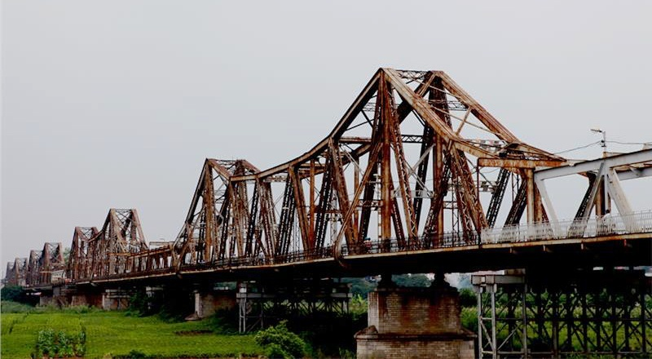
Long Bien Bridge
The bridge was built in 1899–1902 by the architects Daydé & Pillé of Paris, and opened in 1903.
Budget estimation (accepted): 5.390.794 Franc.
Overspent: 6.200.000 Franc.
Time of construction: 4 years (1898–1902) – (estimated: 5 years).

Slide 56

1. University for Science and Technology of Ha Noi (USTH)
The Bilateral project for Education and Training based on Intergovermental Agreement between Viet Nam and France:
“Establishment and Development of University for Science and Technology of Ha Noi”
Budget for Hoa Lac Campus: 213$ – LOAN ADB –
Time: 10 years (2009–2019)
Budget – ODA from France: 100 Million Euros.
ODA (non-returned).

Slide 57

Medical Science and Technology
Information and Communication Technology
Advanced Materials Science and Nanotechnology
Aeronautical Engineering
Applied Environmental Sciences
Space Science and Satellite Technology
Automotive Engineering
USTH’s degree Bachelor programs
Biotechnology-Drug discovery
Engineering Physics and Electronics
Electrical Engineering and Renewable Energy
Data Science
Mechatronics Engineering Technology
Chemistry
Cyber Security
Applied Mathematics

Slide 58
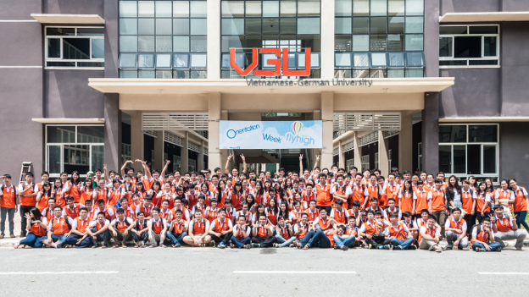
Vietnam German University (2008 )

Slide 59
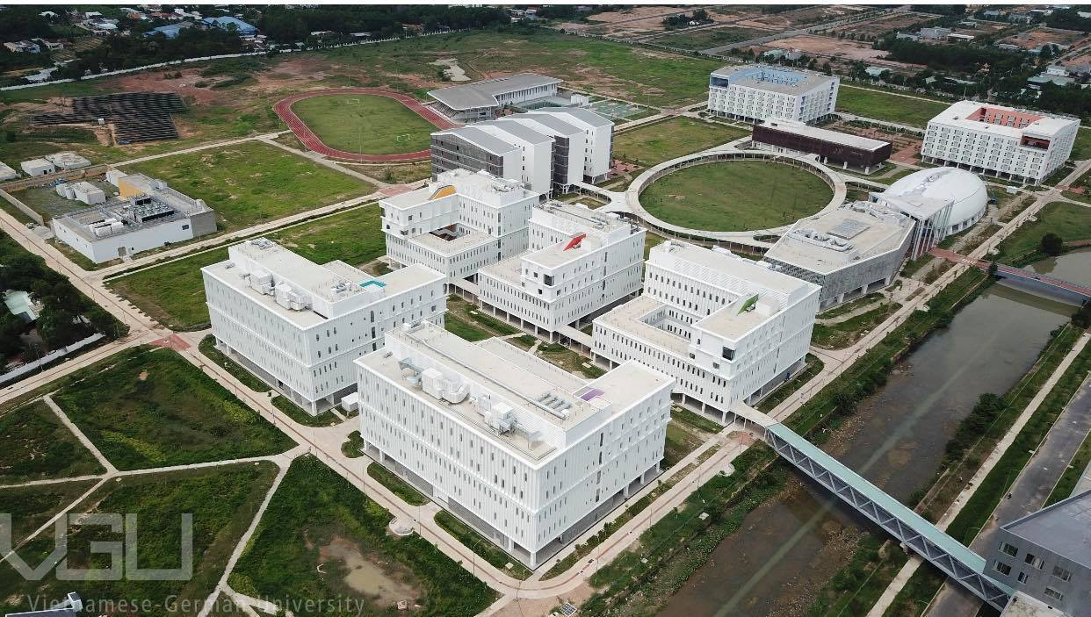
NEW CAPMPUS- Bến cát - Bình Duong

Slide 60

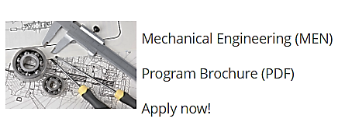

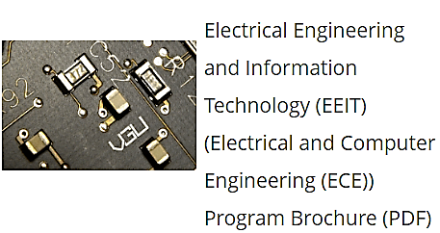



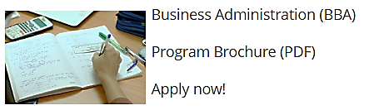
Study Programs
VGU’s degree Bachelor programs

Slide 61
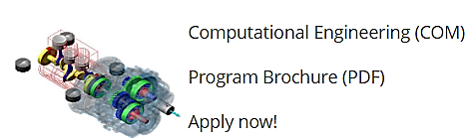
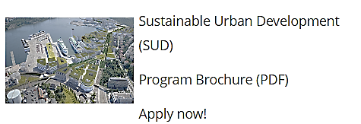
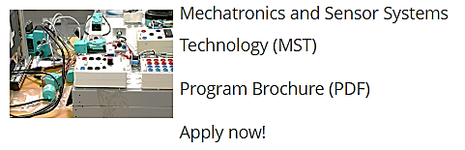
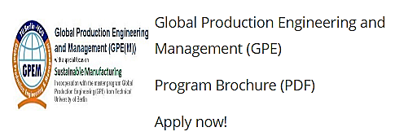

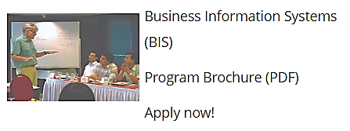

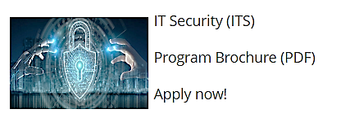
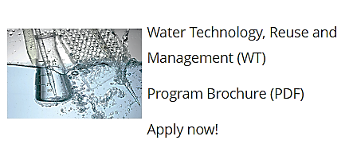

Study Programs
VGU’s degree master programs

Slide 62
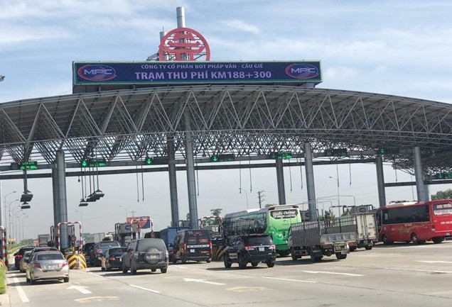
BOT Project Pháp Vân –Cầu giẽ
Phap Van - Cau Gie Expressway (the symbol for the whole route is CT.01) is an important toll highway of Hanoi and the North in general. With a length of 30 km (18 miles)
Construction work on Phap Van – Cau Gie road started on September 4, 1998 and completed phase 1 on January 1, 2002 . 2014 in operation

Slide 63
Disaster prevention projects
Earthquake/′ǝ:kweik/
Tsunami /tsuːˈnɑːmi/ an extremely large wave in the sea caused, for example, by an earthquake ; sóng thần
Flood /flᴧd/ lụt , lũ
Flash flood : a sudden and severe flood ; lũ quét
Mangrove /ˈmæŋɡrəʊv/a tropical tree that grows in mud or at the edge of rivers and has roots that are above ground

Slide 64
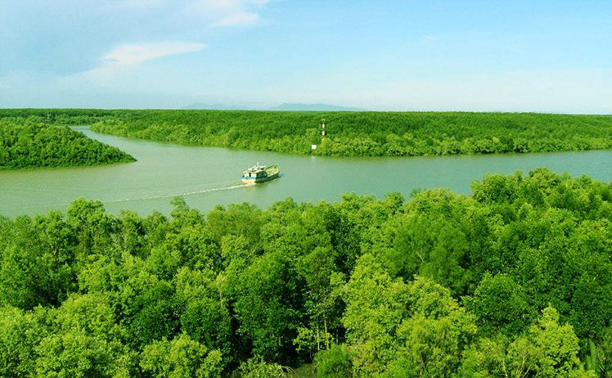
Can Gio Mangrove biosphere reserve

Slide 65
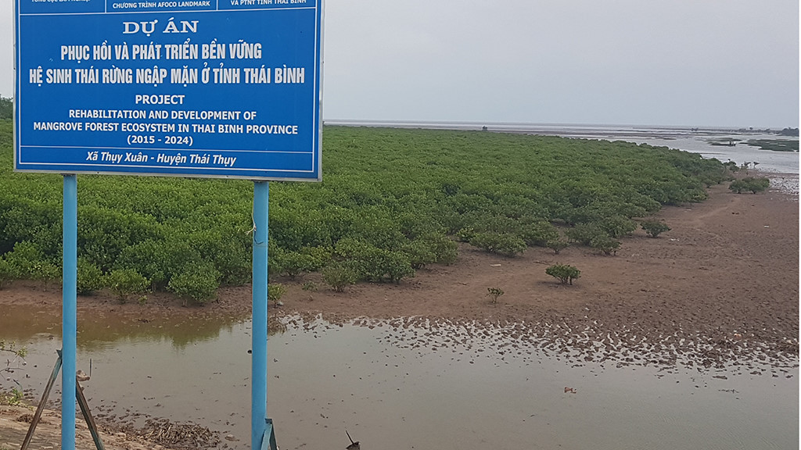
Project on rehabilitation and development of mangrove forest ecosystem in Thai Binh province

Slide 66
Phong Châu Bridge
Công trình được khánh thành vào ngày 28 tháng 7 năm 1995. Vào ngày 9 tháng 9 năm 2024, cầu Phong Châu cũ đã bị sập. Phần đường xe chạy 7m, lề người đi mỗi bên 1m; bề rộng mặt cầu 9,5m. Cầu gồm 8 nhịp, trong đó hai nhịp 6 và 7 được chế tạo từ hai nhịp giàn giản đơn 64m do Bulgaria chế tạo.

Slide 67
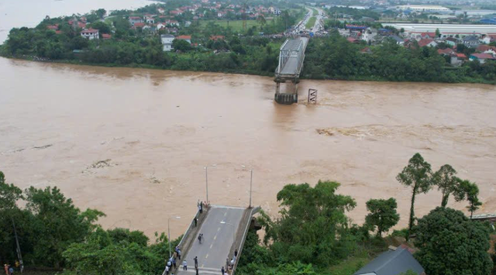

Slide 68
PHONG CHAU BRIDGE
Phong Chau Bridge inaugurated after nine months of emergency construction
Sunday, 16:21, 28/09/2025
VOV.VN - The Ministry of Construction and the People’s Committee of Phu Tho province on September 28 inaugurated and opened to traffic the new Phong Chau Bridge on National Highway 32C.
Construction of the new bridge began on December 21, 2024, and was completed three months ahead of schedule. The bridge is more than 652 meters long and 20.5 meters wide, designed with four traffic lanes. The project had a total investment of over VND635 billion and was managed by the Thang Long Project Management Board under the Ministry of Construction.

Slide 69
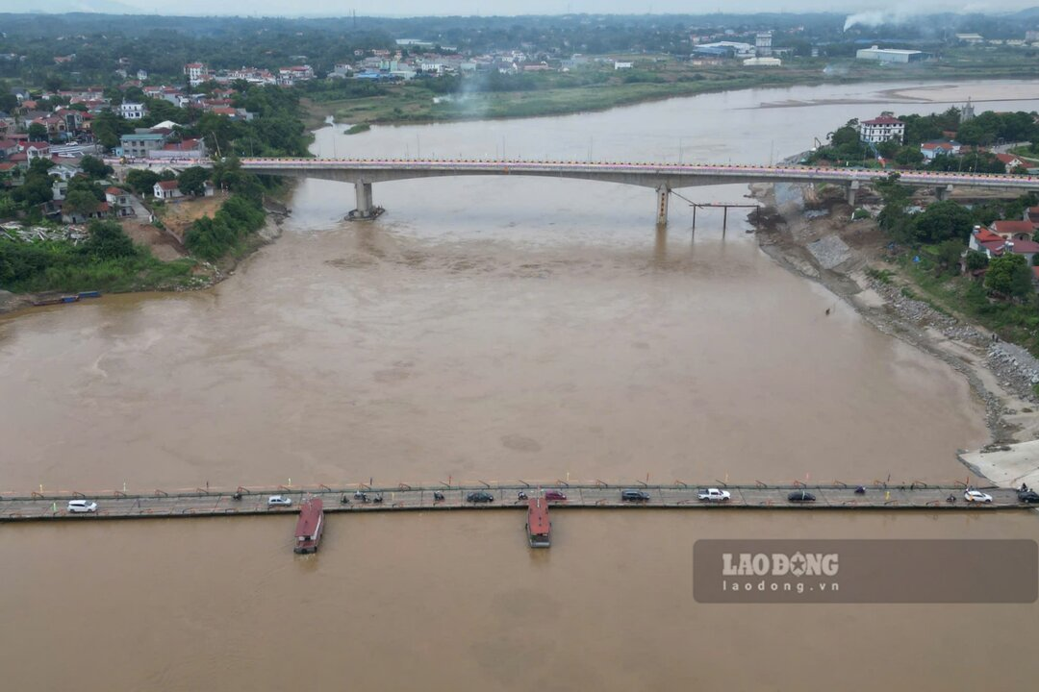
Cầu Phong Châu khánh thành 9/2025

